Slide 1

Deep Belief Networks
Deep Belief Networks (DBNs) are a type of artificial neural network designed for unsupervised learning.

Slide 2
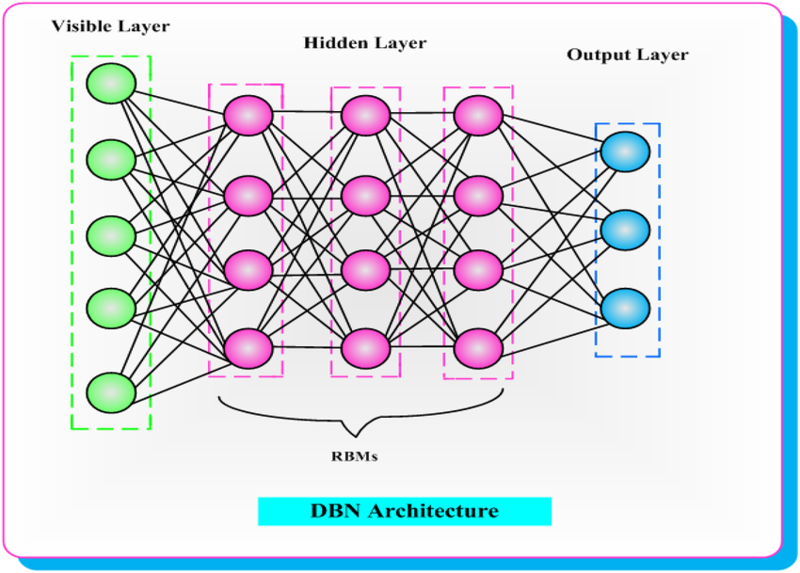
Architecture of a DBN
DBNs are often used for unsupervised learning tasks such as feature learning, dimensionality reduction, and generative modeling.

Slide 3
Breakdown of DBN Architecture
Restricted Boltzmann Machines (RBMs)
Layer-wise Training
Unsupervised Pre-training
Fine-tuning
Top Layer

Slide 4
Restricted Boltzmann Machines (RBMs)
Restricted Boltzmann Machines (RBMs) are a type of artificial neural network that falls under the broader category of generative stochastic networks. RBMs have gained popularity in the field of machine learning, particularly in the context of deep learning.
A DBN is a type of generative deep neural network that is composed of multiple layers of latent variables or hidden units. The most common architecture involves stacking multiple RBMs on top of each other.
Each RBM in the stack is trained independently, and the learned representations from one layer are used as the input for training the next layer. Once all layers are trained, the entire DBN can be fine-tuned using backpropagation.

Slide 5
Applications of DBN
Feature Learning: Extracting hierarchical features from data.
Dimensionality Reduction: Useful in handling high-dimensional data.
Collaborative Filtering: Recommendation systems.
Speech Recognition: DBNs have been used for speech recognition tasks, such as transcribing speech into text.
Natural language processing: DBNs have been used for natural languages processing tasks, such as sentiment analysis and text classification.

Slide 6
Advantages of DBN
Unsupervised training: DBNs learn representations of the input data through unsupervised training, which can increase the model’s accuracy.
Scalability: DBNs are scalable, which enables them to manage sizeable and intricate data sets.
Deep architecture: Because of their deep architecture, DBNs can learn different levels of abstraction from the data, increasing the model’s precision.

Slide 7
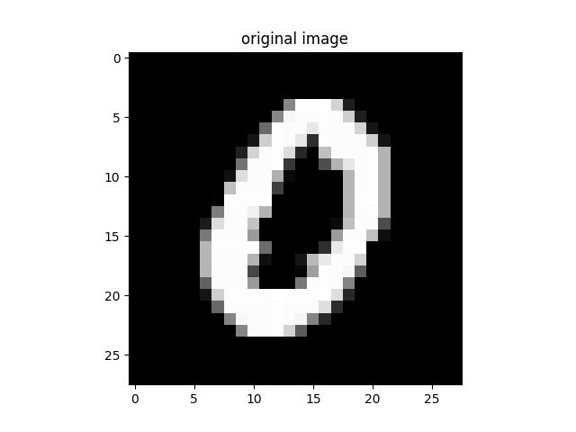
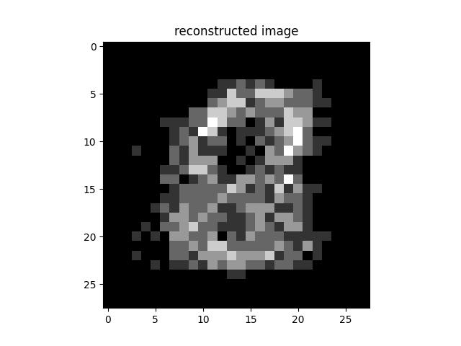
Multilabel Classification using DBNs
Dataset Used: MNIST
Image Dimensions: 28x28
Training Data Size: 28000 Images
Test Data Size: 14000 Images

Slide 8
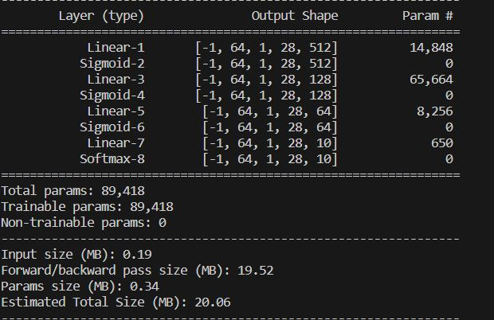
Model Details
Total trainable parameters: 89, 418

Slide 9
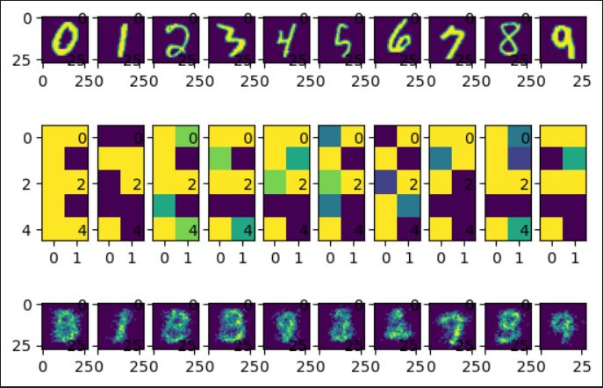
Output Generated
Images reconstructed after passing through the model and the intermediate hidden images displayed.

Slide 10
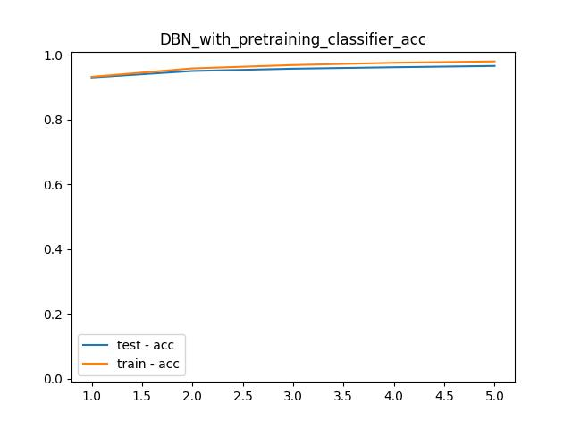
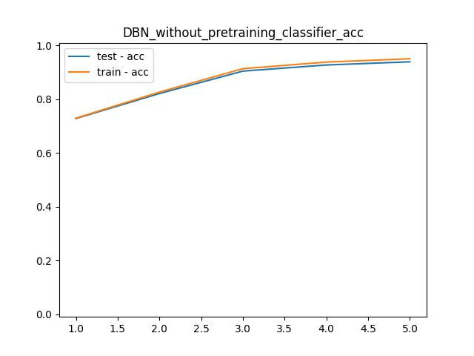
Accuracy
train_acc = 0.9971139971139971
test_acc = 0.9764705882352941
train_acc = 0.9946608946608947
test_acc = 0.9731792717086835

Slide 11
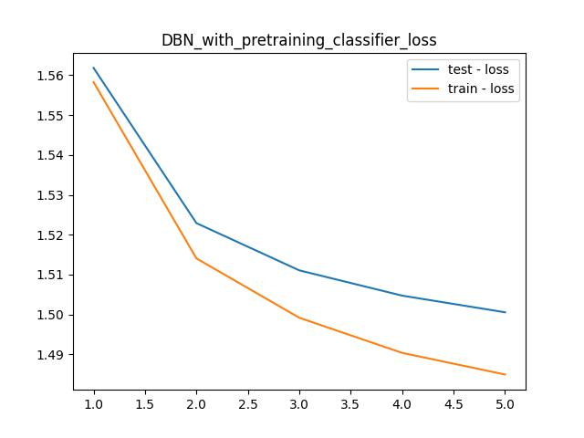
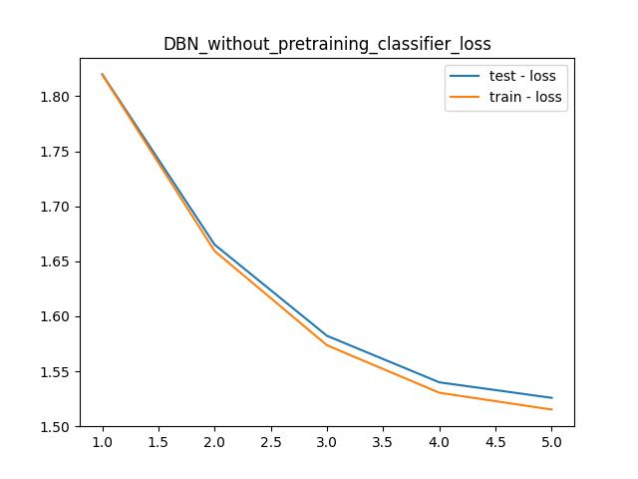
Loss
training_loss: 1.4665071964263916
test_loss: 1.4880313873291016
training_loss: 1.4640227556228638
test_loss: 1.4847303628921509

Slide 12
Links
https://github.com/Pruthvi-1301/Internship_2023
https://github.com/Pruthvi-1301/DBN

